Slide 1
Agriculture in Mexico
Miljan Čavić

Slide 2
Data Information
We have data with 4853 samples from various locations in Mexico, and 75 features.
It felt natural to split it in 4 data sets: wheater data, fertilizing data, soil data, and geographic data.
All my calculations were in regards to yield.

Slide 3
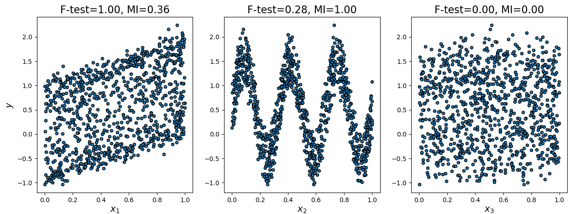
Before we start
“Empirical rule”
Mutual Information
The “empirical rule” states that for roughly bell-shaped distributions:
about 68% of the data values will have z-scores between ±1,
about 95% between ±2,
and about 99.7% between ±3.
We used empirical rule to remove outliers.
We used mutual information score to evaluate connections between features and yield.

Slide 4
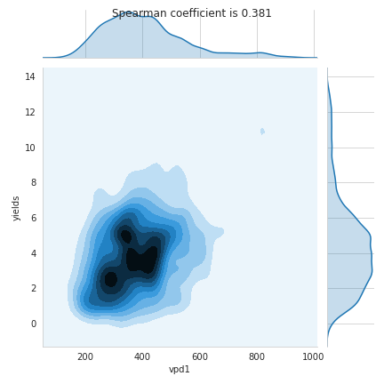
Wheater data
Wheater data has 20 features.
We lost 458 samples due to removing outliers.
The only feature with high correlation coefficient is total vapour pressure deficit in the first stage of plant development (vpd1).

Slide 5
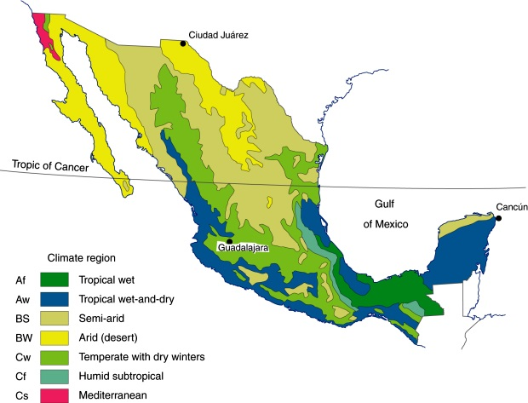
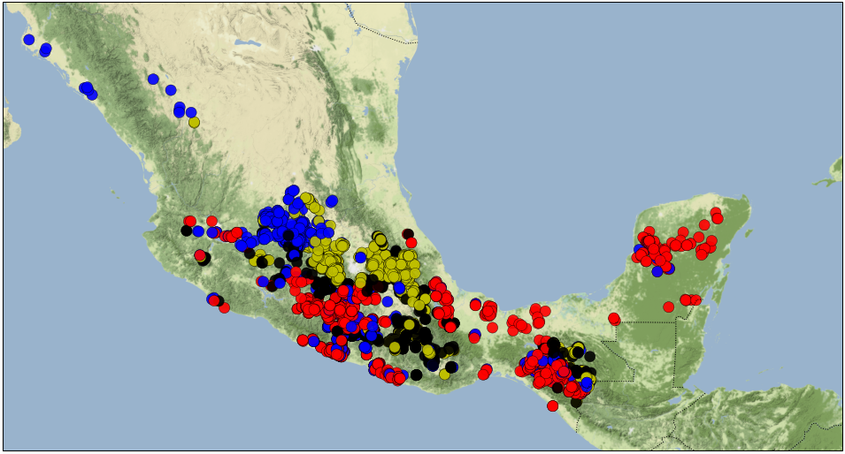
Using wheater data to predict which location belong to which climate region
Black dots are mistake that don’t suit any of this climate regions. (in regard to data)

Slide 6
Fertilizing data
Fertilizing data has 11 features.
We lost 620 samples due to removing outliers.
Features with high spearmen correlation coefficient are:
Overall amount of fertilization including carrier (AMOUNT),
Nitrogen (N),
and irrigation.
Nitrogen also have bigger mutual information score.

Slide 7
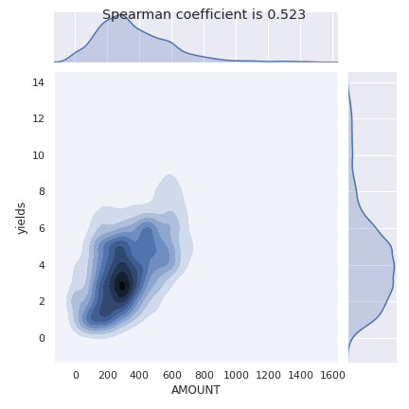
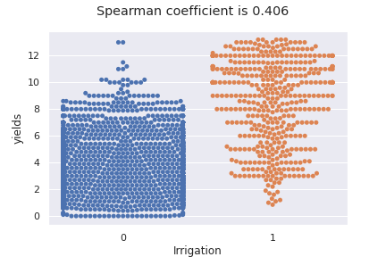
Density estimation for AMOUNT
Swarm plot of Irrigation

Slide 8
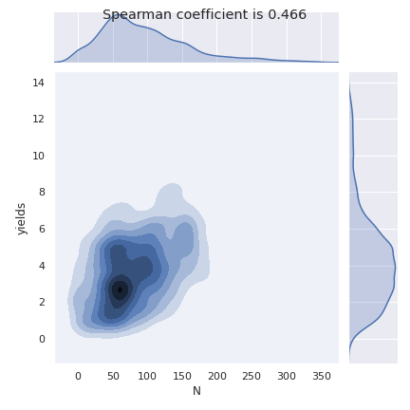
Nitrogen
Besides its high spearman correlation coefficient it also have relatively big mutual information score of 0.37.

Slide 9
Soil data
Soil data has 37 features.
We lost 685 due to removing outliers.
Features with high mutual information score are:
Lower limit, or wilting point at depth of 30~60cm (SLLL_60),
Drained upper limit, or field capacity at depth of 30~60cm (SDUL_60),
Upper limit, saturated at depth of 30~60cm (SSAT_60).
There is only one feature with high spearman correlation coefficient, that is soil pH x 10 in H2O at depth of ~10cm (PHIHOX_sl5).

Slide 10
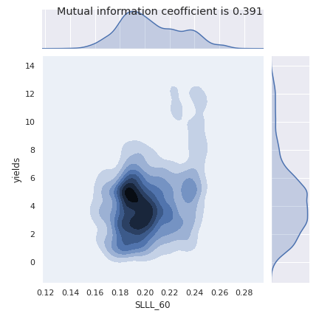
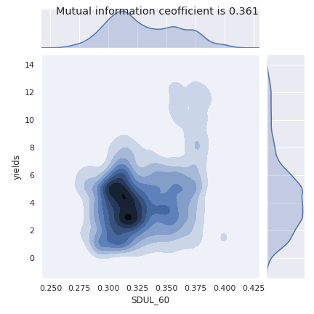
Density estimations for SLLL_60 and SDUL_60

Slide 11
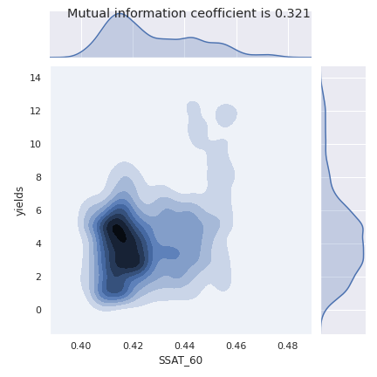
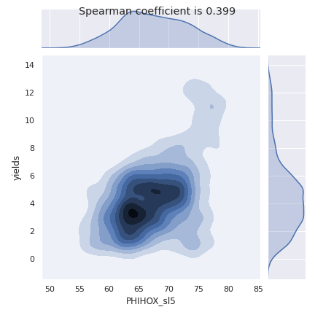
Density estimations of SSAT_60 and PHIHOX_sl5

Slide 12
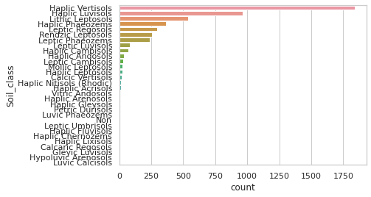
Important feature ‘Soil_class’
This feature are telling us what is the type of soil at some specific locations, there are many soil types, but for next drawings i took only soil types with more then 100 samples.

Slide 13
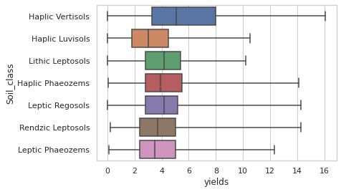
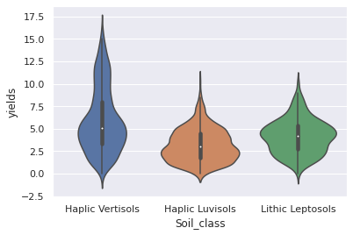
Distribution of yield per soil type

Slide 14
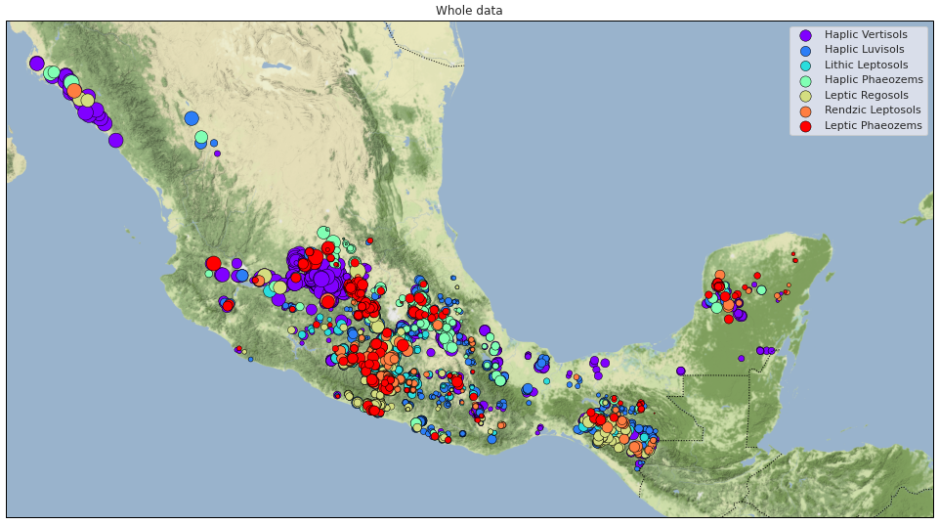
Mapping locations with size relative to yield and color of its soil type

Slide 15
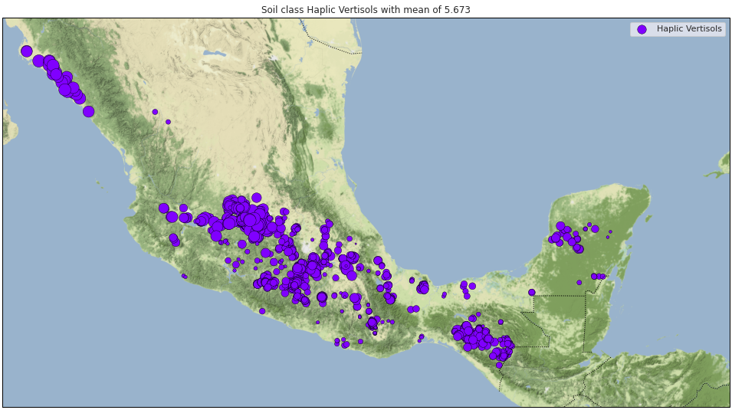
That was a bit messy, let’s try separating it by soil type

Slide 16
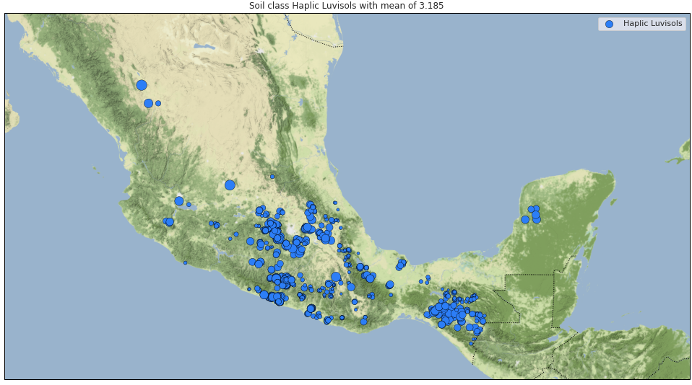

Slide 17
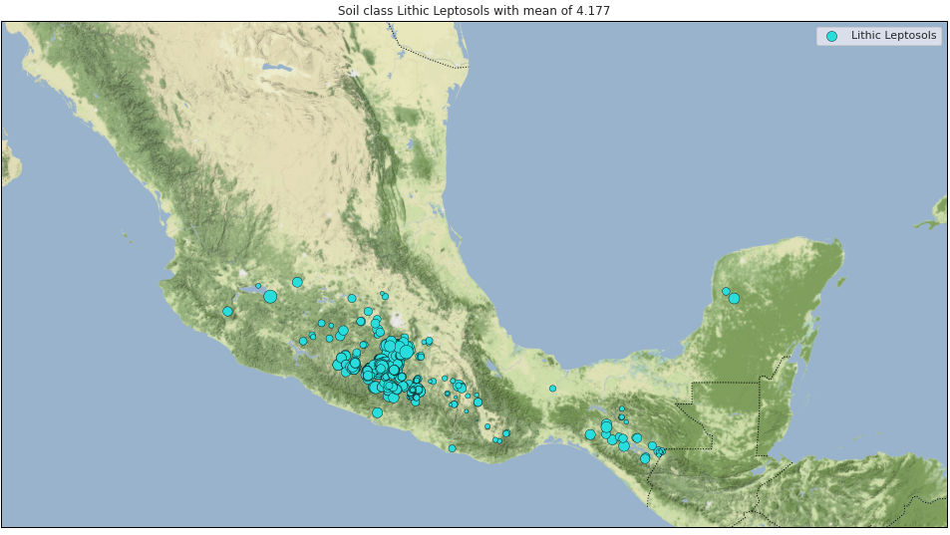

Slide 18
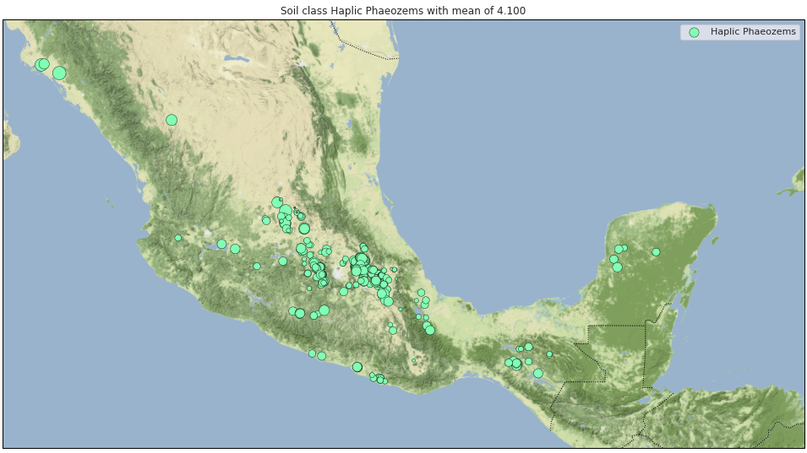

Slide 19
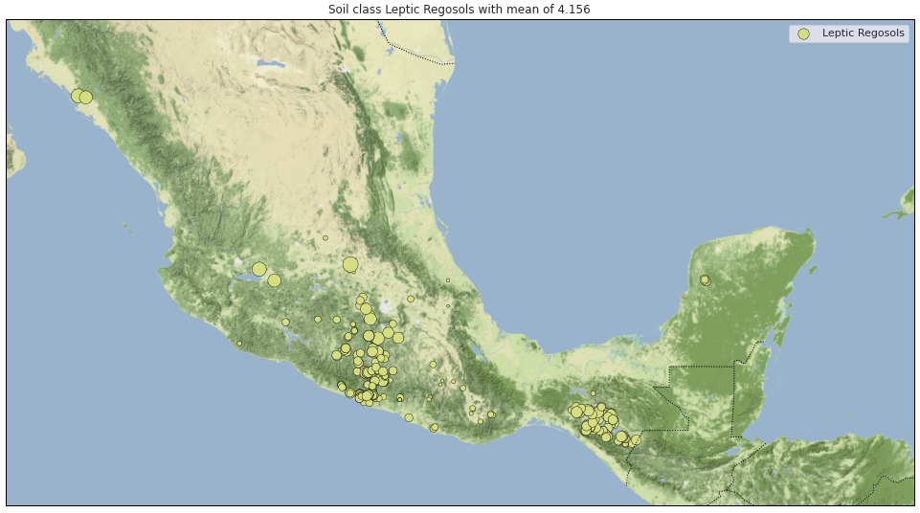

Slide 20
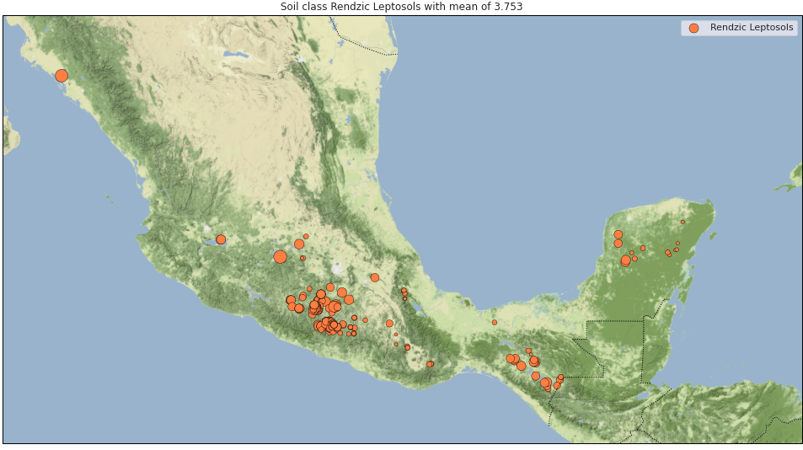

Slide 21
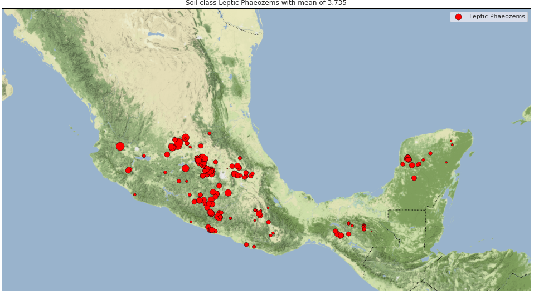

Slide 22
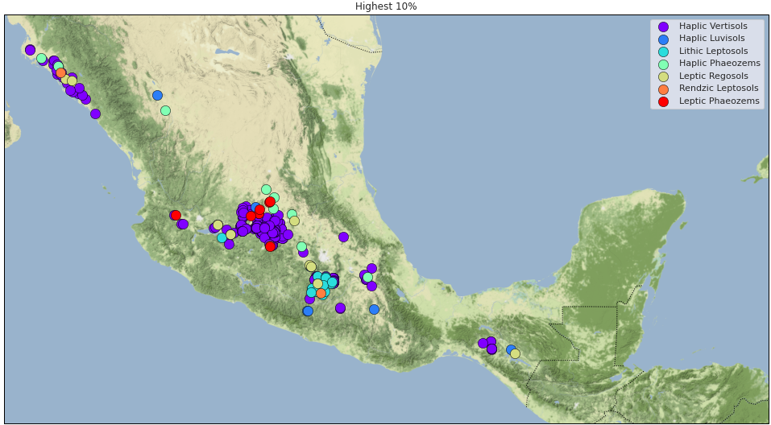
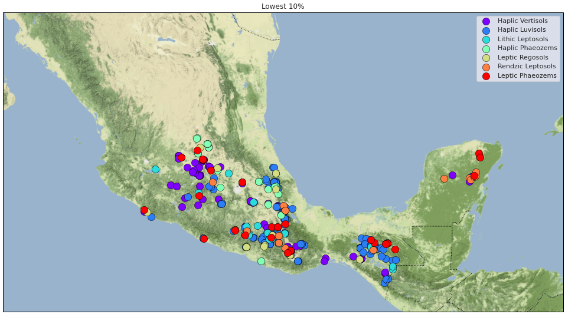
Let’s see where are top 10% and bottom 10% in regards to yield

Slide 23
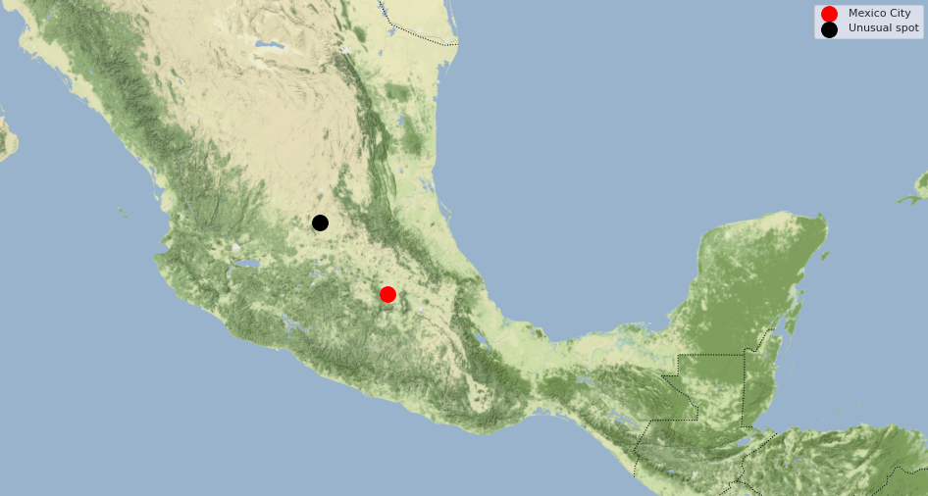
Some unusual spot
While running calculations on data sets, i accidentally run mutual information test on data coordinates.
It gave me strange results at this unusual location.

Slide 24
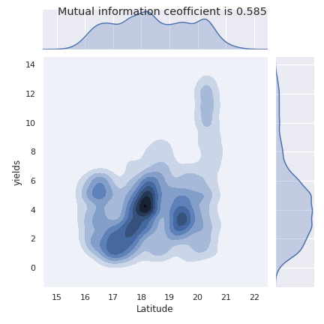
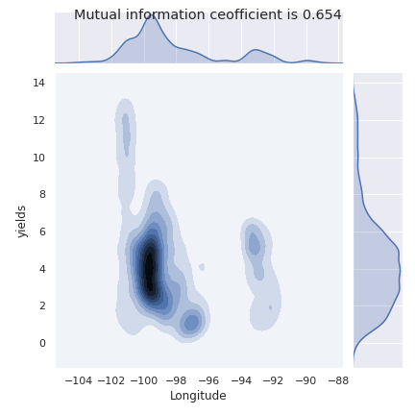
How it look at density estimation

Slide 25
Thank you for your time.

Slide 26
Any questions?

